Slide 1

Department of Computer Science & Engineering
Project Work Phase – II (15CSP85)
Review 2
Title: Women Security System
Guide: Swathi K
Asst. Prof, Dept of CSE
GROUP-04 BATCH-09
Team Members: 1. Sirisha M (1KS15CS102)
2. Siddharth Meharwade (1KS15CS099)
3. Suraj Kumar (1KS15CS109)
4. Shiv Shankar Sah (1KS15CS095)
Date: 03/04/19

Slide 2
Problem Statement
In an emergency situation like being stalked, physical assault, violence, any women for that matter gets panicked hence to safe-guard herself she needs to inform about her location and status to her close ones.
When in panic, she may not be able to operate her smartphone safety applications immediately, also while using it she may be attacked.
Hence there is a need for immediate protection and alerting her close one’s, hence our security system can be adopted to overcome such situations.

Slide 3

Objectives
The main aim of our project “Women Security System” is to provide an effective and smart way of alerting the victim’s (women in danger) close one’s about her location when she’s in danger.(This is just a Prototype).
This Project presents a women safety detection system using GPS and GSM modems.
This detection and messaging system is composed of a GPS receiver, Microcontroller and a GSM Modem. GPS Receiver gets the location information from satellites in the form of latitude and longitude.
A GSM modem is interfaced to the MCU. The GSM modem sends an SMS to the predefined mobile number and protect the women from danger.
We provide the system in a hidden way using a handbag.

Slide 4
Technology Used
HARDWARE:
Microcontroller - Arduino
Display - 16X2 LCD
Communication - GPS/GSM
Sensors - heart beat sensor
Display - 16X2 LCD
SOFTWARE:
Embedded C with Arduino – An embedded system is combination of computer hardware and software, either fixed incapability or programmable, that is specifically designed for particular kind of application device

Slide 5
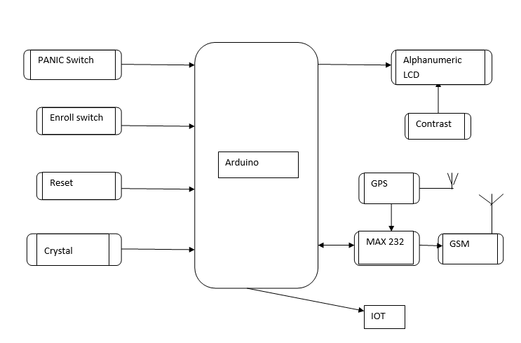
System Design
Fig : System Block Design

Slide 6
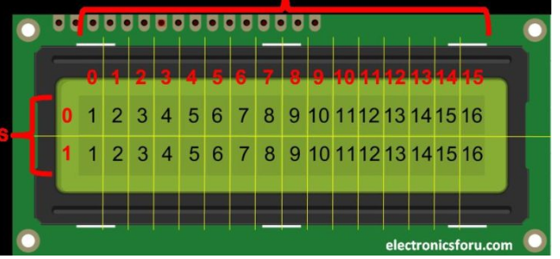
System Design
LCD DISPLAY-LCDs are available to display arbitrary images which can be displayed or hidden, such as pre-set words, digits and 7 segment displays as in a digital clock..
CRYSTAL OSCILLATOR: Crystal oscillator is used to produce oscillated pulses which is given to the microcontroller.

Slide 7
System Design
GSM MODEM: Global system for mobile communication (GSM) is a globally accepted standard for digital cellular communication which
GPS RECEIVER: GPS, in full Global Positioning System, space-based radio-navigation system that broadcasts highly accurate navigation pulses to users on or near the Earth.

Slide 8
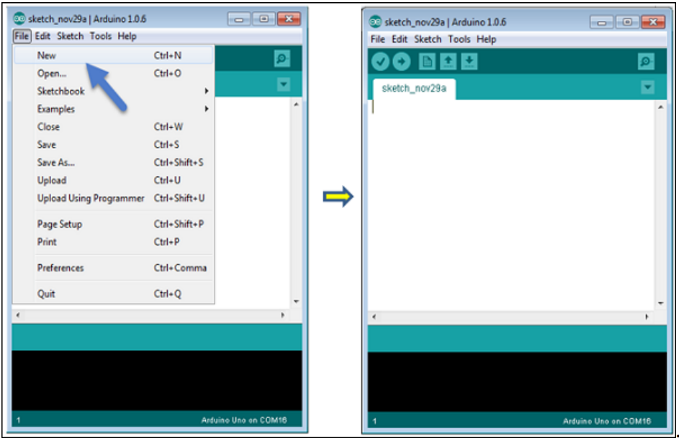
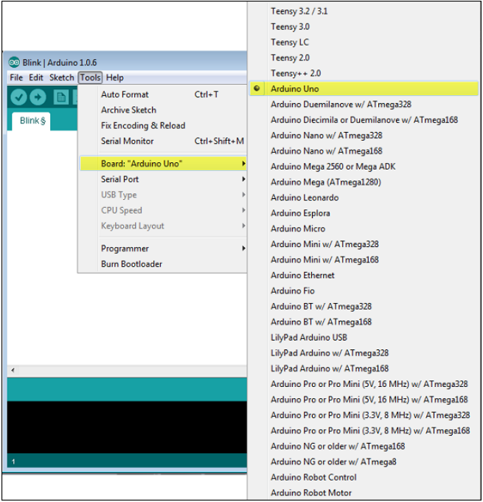
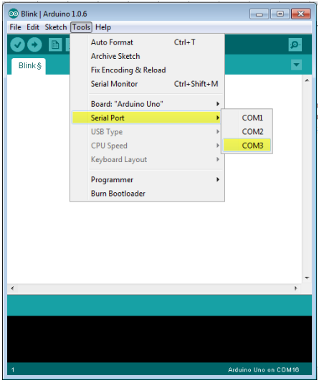
Implementation-Software
Fig a
Fig a: Opening a new project.
Fig b: Selection of board and MCU
Fig c: Selection of serial port
Fig b
Fig c

Slide 9
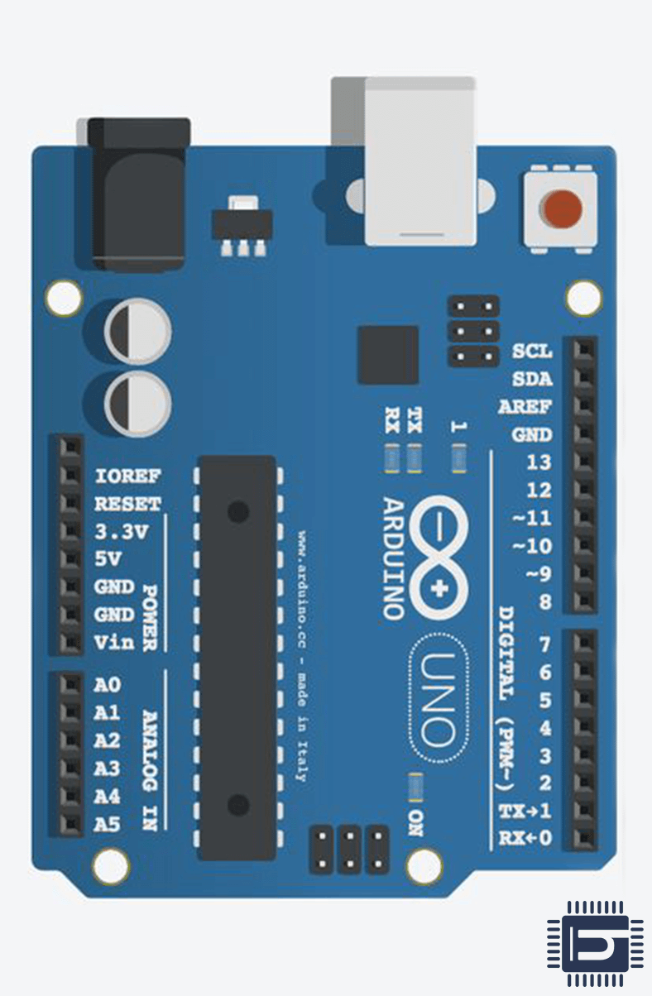
Implementation-Hardware
Arduino Microcontroller
Arduino UNO is a single-board microcontroller.
Cost less and provides a miniature computer system.
It contains everything needed to support the microcontroller Like:
Digital and analog pin.
16 MHz Quartz crystal.
USB connection .

Slide 10
Implementation-Hardware
POWER SUPPLY CIRCUIT
Power Supply
DC Supply
AC Supply
Transformer
Rectifier
Filter
Regulator
Load /Circuit
Fig: Power Conversion diagram
Power supply circuit convert the 220v supply to 12v power supply.
It also convert the AC power supply to DC power Supply.

Slide 11
Implementation-Code
Code Snippets are added here:
#include <LiquidCrystal.h>
#include <stdio.h>
#include <SoftwareSerial.h>
SoftwareSerial mySerial(8, 9);
LiquidCrystal lcd(6, 7, 5, 4, 3, 2);
// defines pins numbers
//New GPS GY-GPS6MV2
int panic = 11;
int button = A1; //shock
int heart = 10;
int relay = 12;
Snippet : Showing Declaration of variables

Slide 12
Implementation-Code
Code Snippets : SMS Sending
Serial.write("AT+CMGS=\"");
Serial.write(pastnumber);
Serial.write("\"\r\n"); delay(2500);
Serial.write("IOTlinks https://api.thingspeak.com/update?api_key=CYASIOD5YUQK6RJE&field1=");
converts(hbtc1);
Serial.write(0x1A); delay(4000); delay(4000);
Serial.write("AT+CMGS=\"");
Serial.write(pastnumber);
Serial.write("\"\r\n"); delay(2500);
Serial.write("IOTlinks https://api.thingspeak.com/update?api_key=CYASIOD5YUQK6RJE&field2=");
for(ii=0;ii<=6;ii++){Serial.write(finallat[ii]);}
Serial.write(0x1A); delay(4000); delay(4000);
Snippet : Showing Sending of messages.

Slide 13
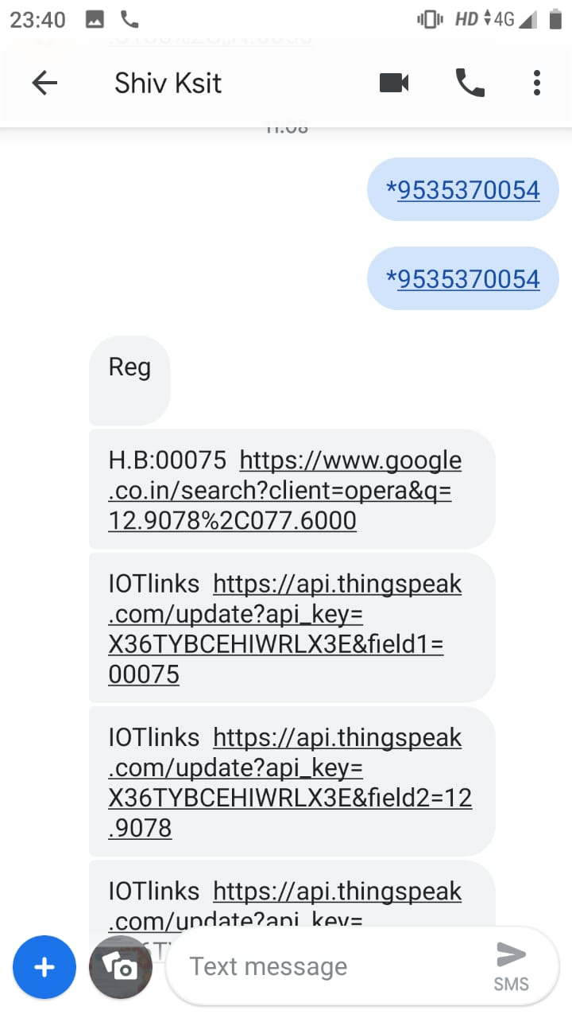
Testing And Results
Register a mobile number of the victim’s close one’s..
* followed by phone number of the person who wants to register.
We get a msg “REG” if successfully registered.
Test Successful.
Fig: Registration Step

Slide 14
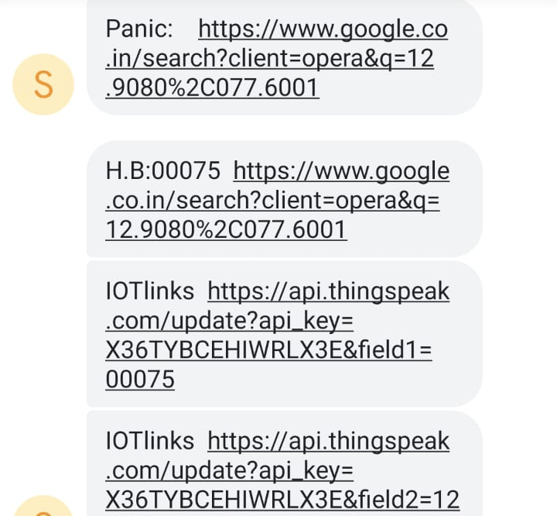
Testing And Results
After Panic Situation .
Message is sent to registered person.
Message consist of following:
Heart Beats Rate
GPS Location
Fig: Message After Panic to Receiver

Slide 15
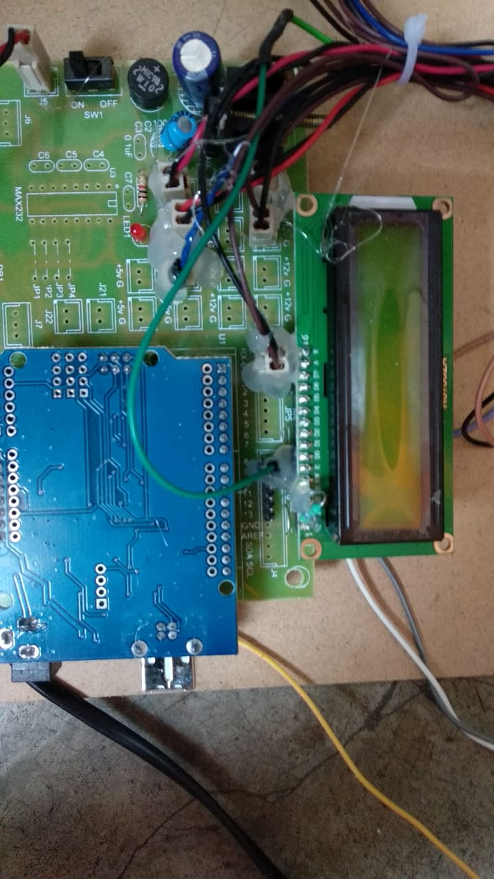
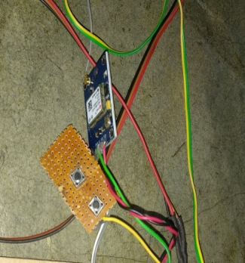
SNAPSHOTS
Fig -Power supply board with Arduino.
Fig - Panic switches

Slide 16
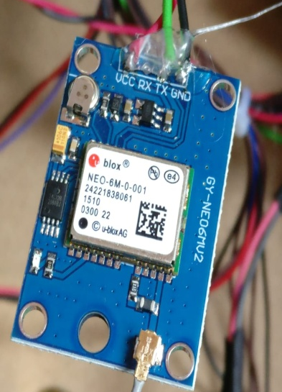
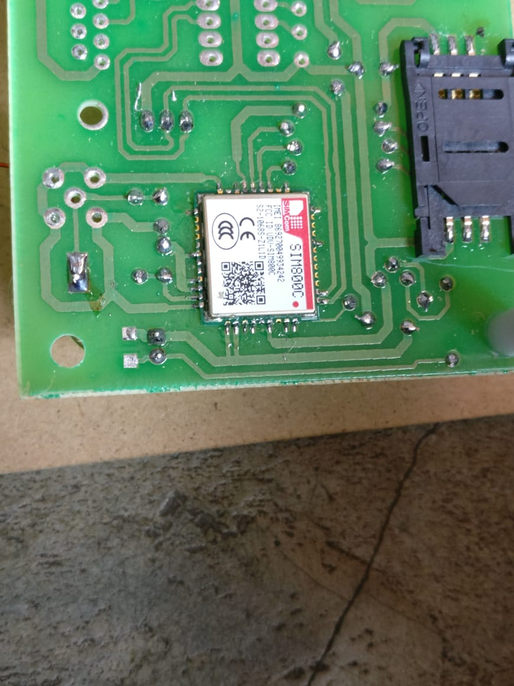
SNAPSHOTS
Fig - GPS
Fig - GSM

Slide 17
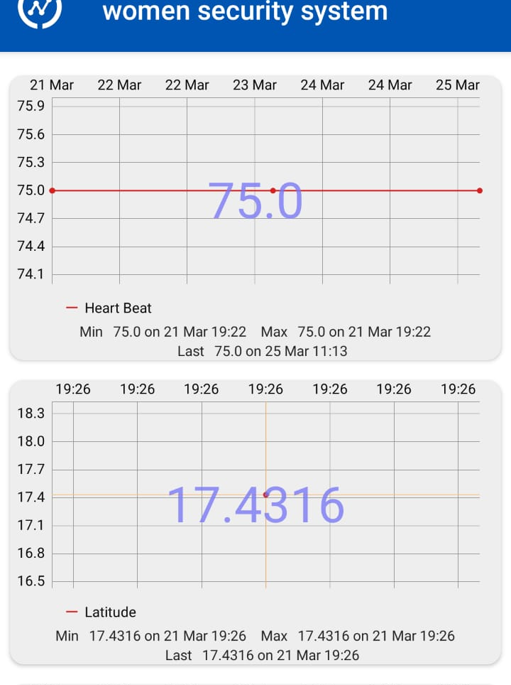
Snapshots
Fig : Showing Heart Beat and Location data using a third party app to track the victim, called thingview.

Slide 18
Github And BlogSpot Link
https://github.com/projectwork09/Women-Security
womensecurityproject09.wordpress.com

Slide 19
References
[1] A mobile-based women safety application (I safe Apps). Dr. Sridhar Mandapati, Sravya Pamidi, Sriharitha Ambati," A Mobile-based Women Safety Application (I Safe App)". Vol 17, Issue 1, Ver. I (Jan – Feb. 2015)
[2] Advanced Security system for women. Deepak Sharma, Abhijit Paradkar “All in one Intelligent Safety System for Women Security”. Vol 130 No.11 November 2015.
[3] Smart Shield for Women Safety. Rachana B Pawar, Manali H. Kulabkar, Kirti S. Pawar Akshata R. Tambe Prof. Smita Khairnar. “Smart Shield for Women Safety”. Volume: 05 Issue: 04 | Apr-2018

Slide 20
Thank You

